Slide 1
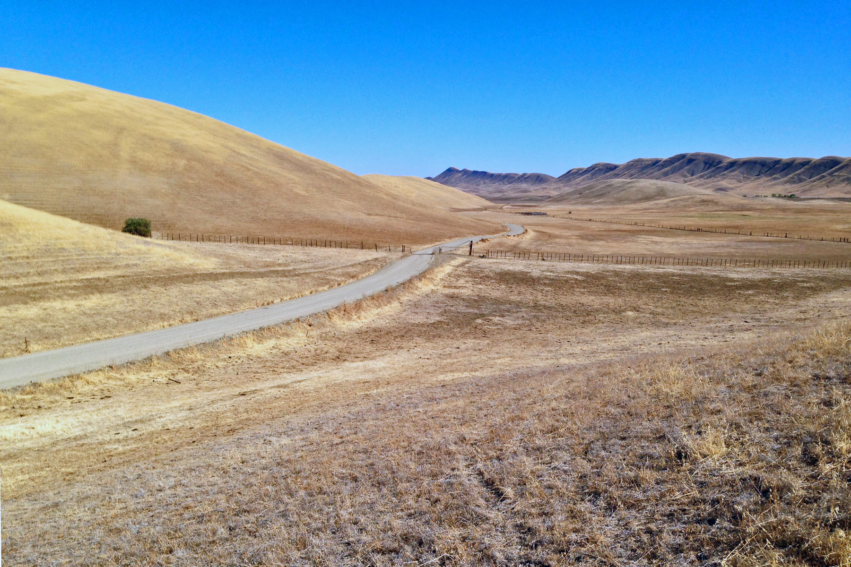

CDFW - Sites 60 day Evaluation
Initial Meeting
            June 18, 2019
Sites

Slide 2
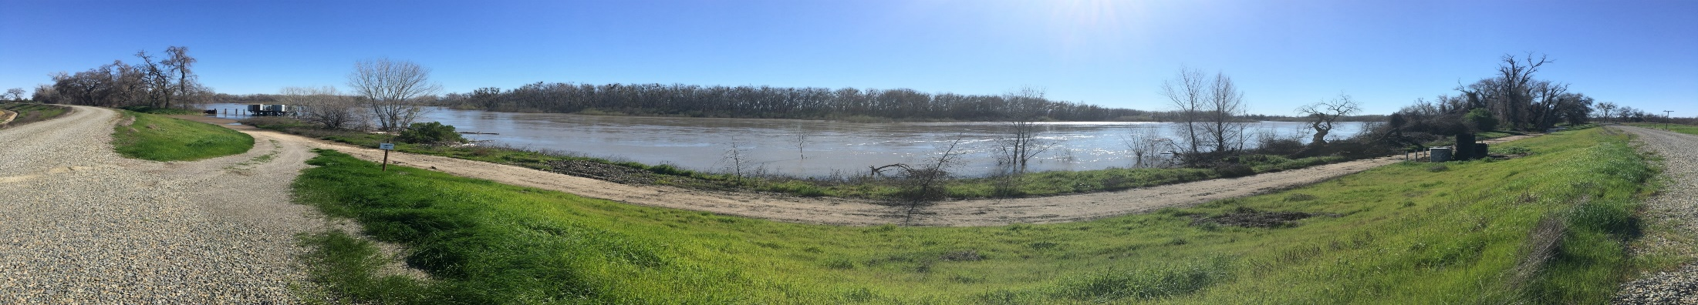
Agenda
    Introductions and Purpose
    Project overview and understanding
      Location/Facilities
      Project Purposes
      Key Topics
    Permitting Approach
    Next Steps

Slide 3
Purpose of the 60-day
    Guide the Authority to increase the clarity of the Project Description and supporting analyses for an affordable project capable of providing meaningful water supply and dedicated ecosystem benefits looking toward
    Final EIR/EIS
    Permit applications

Slide 4
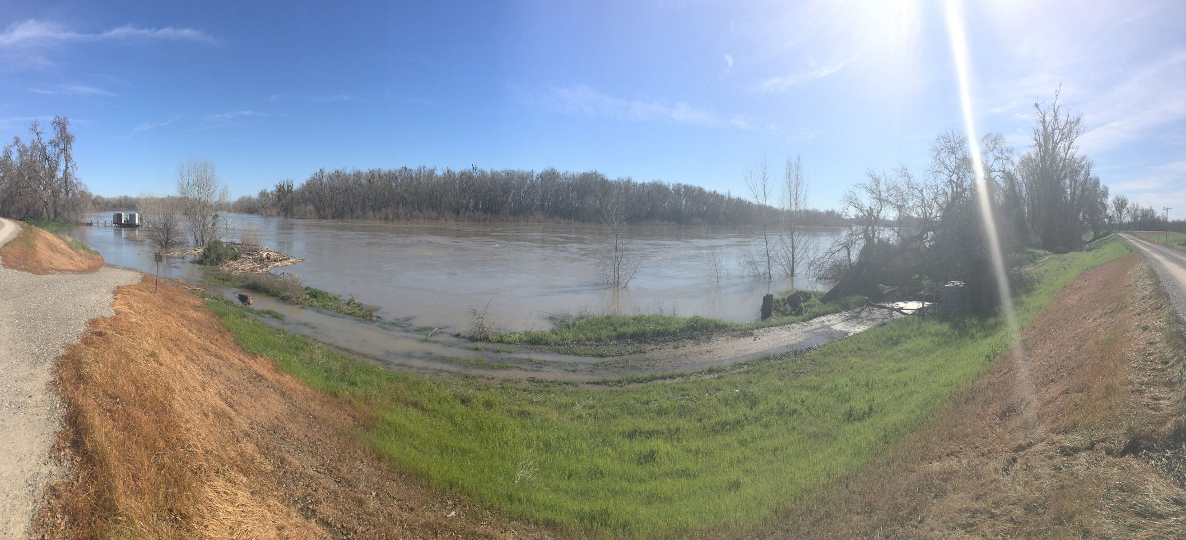

Regional Map
4
Notes:
Sites is a sustainable surface water project that uses available facilities and adds storage and conveyance to:
improve conditions for chinook salmon in drier years and delta smelt in all late-summers and falls
Increases deliveries to wildlife refuges in dry years
Eliminates floods that closed I-5
Increases water supplies for families, farms and business in drier years
Is more effective as climate changes occurs

Slide 5
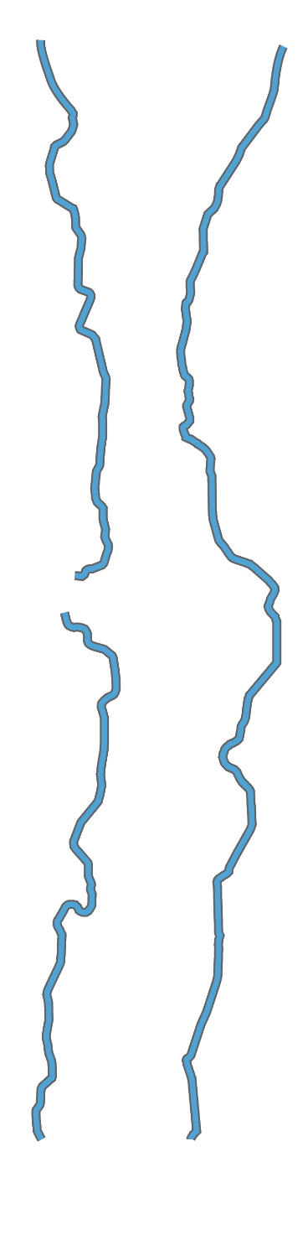
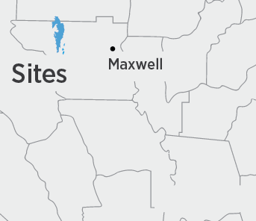
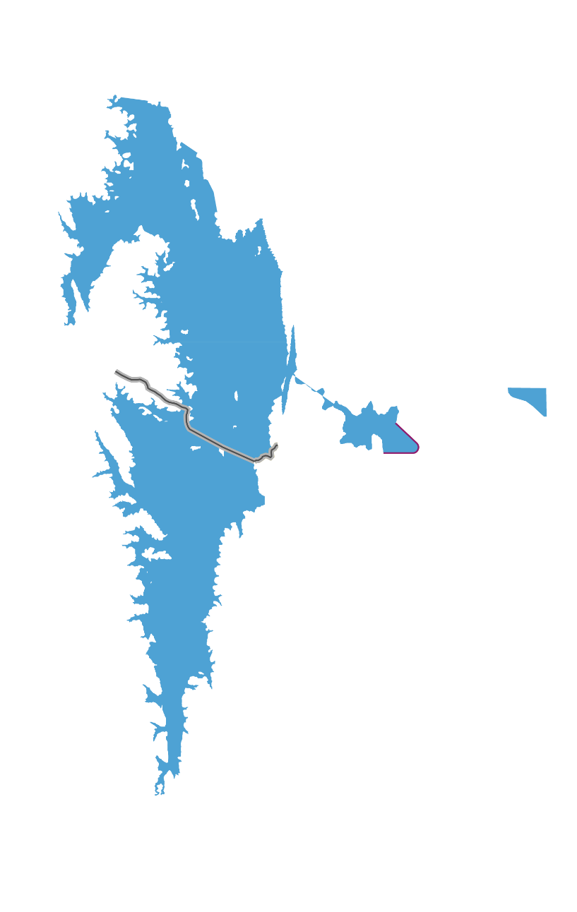
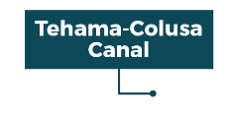
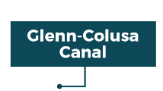



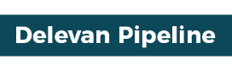

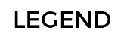

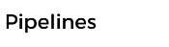

Project Facilities
Sacramento River
Maxwell
Pumping Plants
5
Notes:
If 1.8 MAF is not affordable (permit conditions or reduced participation), purse a smaller-sized project. Environmental Analysis has been done on a 1.3 MAF reservoir (with same size facilities).
If smaller-sized project is not affordable (permit conditions or reduced participation), pursue the Intertie between the T-C Canal and GCID Canal. Concept has been previously studied. Expect only Sacramento Valley participation, which would likely reduce the size and cost. With an intertie, an asset has been created.

Slide 6
Key Topics/Anticipated Issues
Approach to address CEQA comments
  Mitigation
  Surveys
Approach for Permits (2081 ITP and 1600) Construction and Operations
Species to be covered in the 2081 ITP
Fully protected species
Birds – nesting, resident, and migratory
Approach for special status plants and surveys

Slide 7
Proposed Permitting Approach
  2081 Incidental Take Permit
    Construction and Operations
    Define Impact Area
    Proposed terrestrial species
    Federal and state listed species
    Impact analysis approach
    Fully mitigate
  Lake or Streambed Alteration Agreement
    Standard permit or long-term
    Jurisdictional area
    Reports needed for the agreement
7

Slide 8
Approach to 2081 ITP
Desktop modeling approach for species
Assuming presence
Fully mitigate
Plant surveys prior to construction

Slide 9
State Listed Terrestrial Species
Species | Federal Status | State Status
Foothill yellow-legged frog | No listing | Candidate, Threatened
Giant garter snake | Threatened | Threatened
Swainson’s hawk | No listing | Threatened
Bank swallow | No listing | Threatened
Western yellow-billed cuckoo | Threatened | Endangered
Tricolored blackbird | No listing | Threatened
Palmate-bracted bird’s beak | Endangered | Endangered

Slide 10
Terrestrial Species Models
Foothill yellow-legged frog | Perennial and intermittent streams with rocky substrates (not Sacramento River), Stone Corral Creek, Funks Creek (above reservoir), Antelope Creek
Giant garter snake | (Valley floor) AQUATIC - agricultural ditches, canals, freshwater emergent wetland, managed wetland, rice . UPLAND - areas within 200 feet of aquatic habitat that include annual grassland, other ag, disturbed, barren.
Western yellow-billed cuckoo | Dettling et al.; (2015) Sacramento River, areas 100m wide and patches of at least 37 acres.
Swainson's hawk | NESTING - Riparian, other tree stands, isolated trees (not blue oak woodland); FORAGING - Minimum of 5-acre patches. Annual grassland, seasonal wetlands, alfalfa, hay fields, field crops, row crops, managed wetlands

Slide 11
Terrestrial Species Models cont.
Palmate-bracted bird’s beak | Model will assume some portion of grasslands contain saline-alkali seasonal wetlands.
Tricolored blackbird | NESTING - emergent marsh, managed wetland, riparian (blackberry thickets) FORAGING - annual grassland, seasonal wetland, grain/hay crops, field crops, rice, fallow
Bank swallow | Sacramento River banks provide potential habitat

Slide 12
Mapping Approach
ICF is mapping land cover through aerial photo interpretation using
Google Earth
National Agricultural Imagery Program (NAIP) imagery
Other data available for the project

Slide 13
Schedule (Proposed)
June 25: Topic B: Proposed terrestrial species (GGS, WYBC, FYLF, Swainson’s hawk, tricolored blackbird, bank swallow) to be covered in 2081 ITP and jointly covered species for BA (GGS and WYBC), discuss proposed analysis approach, minimization measures and mitigation
July 2: Continue discussion of Topic B
July 9: Topic C: Fully protected species avoidance measures during construction and flooding of the reservoir (American peregrine falcon, golden eagle, bald eagle, white-tailed kite, greater sandhill crane, and ringtail)
July 16: (skip)
July 23: Topic D: Birds – measures to protect nesting, resident, and migratory birds; construction of transmission lines to meet APLIC guidelines
July 30: Topic E: Plants – Special status plant surveys, proposed analysis, and conservation measures

Slide 14
