Slide 1
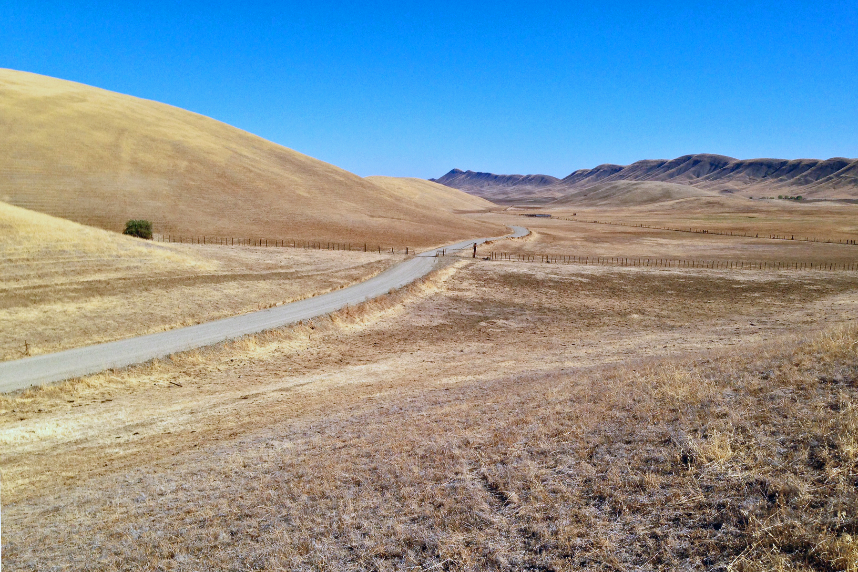

CDFW - Sites 60 day Evaluation
Initial Meeting
            May 30, 2019
Sites

Slide 2
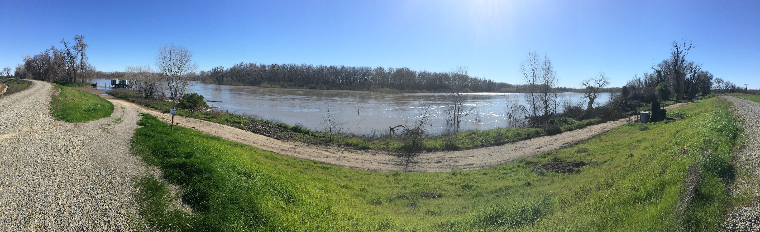
Agenda
    Introductions and Purpose
    Project Overview & Updates
    Operations Simulations – Hydrology & Tools
    Operations Results
    Tools
    Next Steps

Slide 3
Purpose of the 60-day
    Guide the Authority to increase the clarity of the Project Description and supporting analyses for an affordable project capable of providing meaningful water supply and dedicated ecosystem benefits looking toward
    Final EIR/EIS
    Permit applications

Slide 4
Anticipated Issues
    Diversion rate and timing
    Trigger values
    Floodplain and Bypass habitat
    Coldwater pool development and release
    Flow stability supply development and release effects
    Flow-mortality analysis and scientific basis
    Sites Reservoir water quality and release effects
    Sediment management
    Delta Outflow management and effects

Slide 5
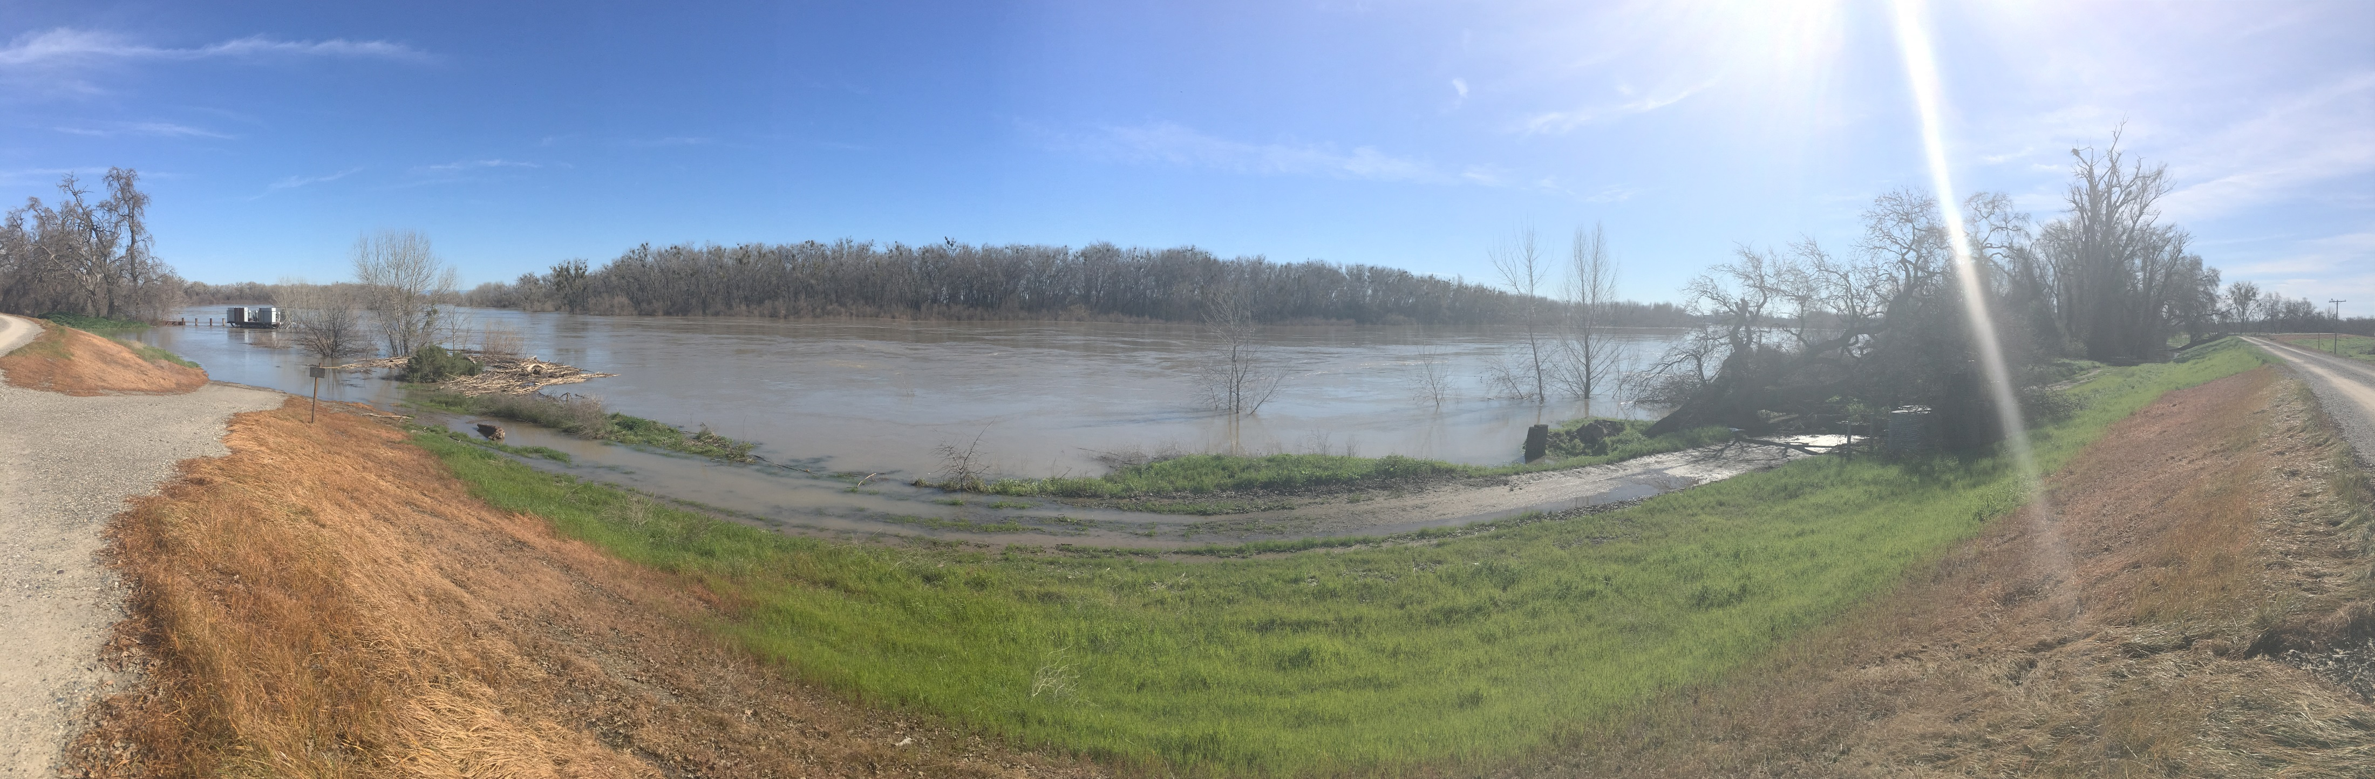

Regional Map
5
Notes:
Sites is a sustainable surface water project that uses available facilities and adds storage and conveyance to:
improve conditions for chinook salmon in drier years and delta smelt in all late-summers and falls
Increases deliveries to wildlife refuges in dry years
Eliminates floods that closed I-5
Increases water supplies for families, farms and business in drier years
Is more effective as climate changes occurs

Slide 6
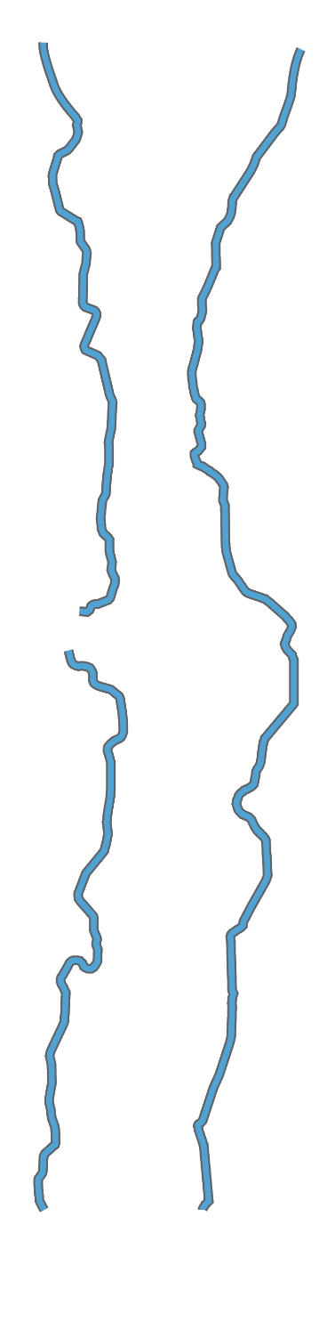
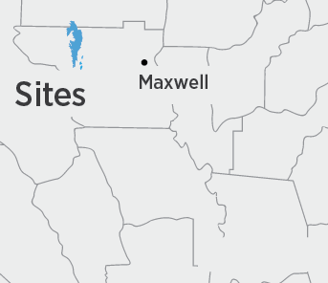
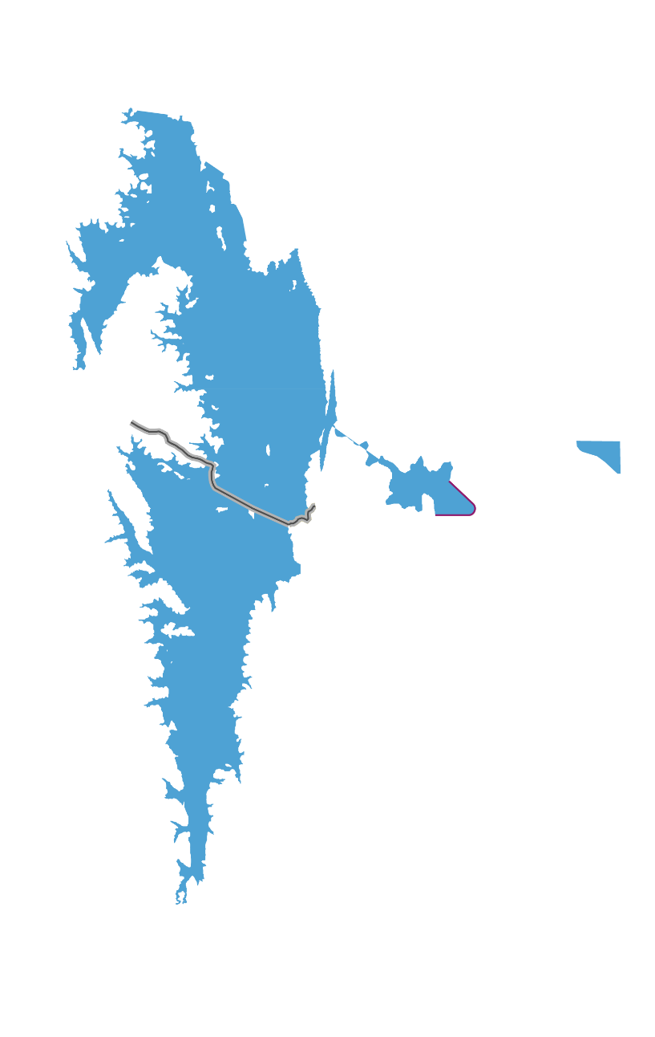
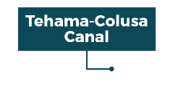
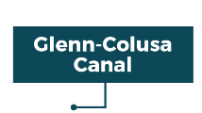


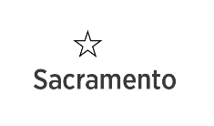
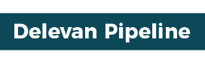

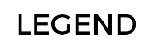

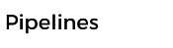

Project Facilities
Sacramento River
Maxwell
Pumping Plants
6
Notes:
If 1.8 MAF is not affordable (permit conditions or reduced participation), purse a smaller-sized project. Environmental Analysis has been done on a 1.3 MAF reservoir (with same size facilities).
If smaller-sized project is not affordable (permit conditions or reduced participation), pursue the Intertie between the T-C Canal and GCID Canal. Concept has been previously studied. Expect only Sacramento Valley participation, which would likely reduce the size and cost. With an intertie, an asset has been created.

Slide 7
Sites Project
Analytical Modeling Framework
Climate Change Modified Hydrology
Sea Level Rise
VIC, ANN
Hydrology &
System Operations
CALSIM II Merged Model, USRDOM (daily Model)
Power
LTGEN, SWP Power,
NODOS Power,
Reservoir/River Temp
Reclamation HEC5Q
Water supply impacts, river flows, exports, storage
Net Generation and Use
Reservoir, River temperatures
Delta Hydrodynamics
DSM2-HYDRO
Fisheries
Early Lifstage Mortality, SALMOD,
WRCLCM (IOS), OBAN
Delta channel flows, stages, velocities
Economics
SWAP,
CWEST, LCRBWQM/SBWQM
Survival, Potential Production, Population
Quantification of
Economic Benefits
Delta Water Quality
DSM2-QUAL
Salinity (EC, Cl, TDS, Br) and fingerprinting (EC, volume)

Slide 14
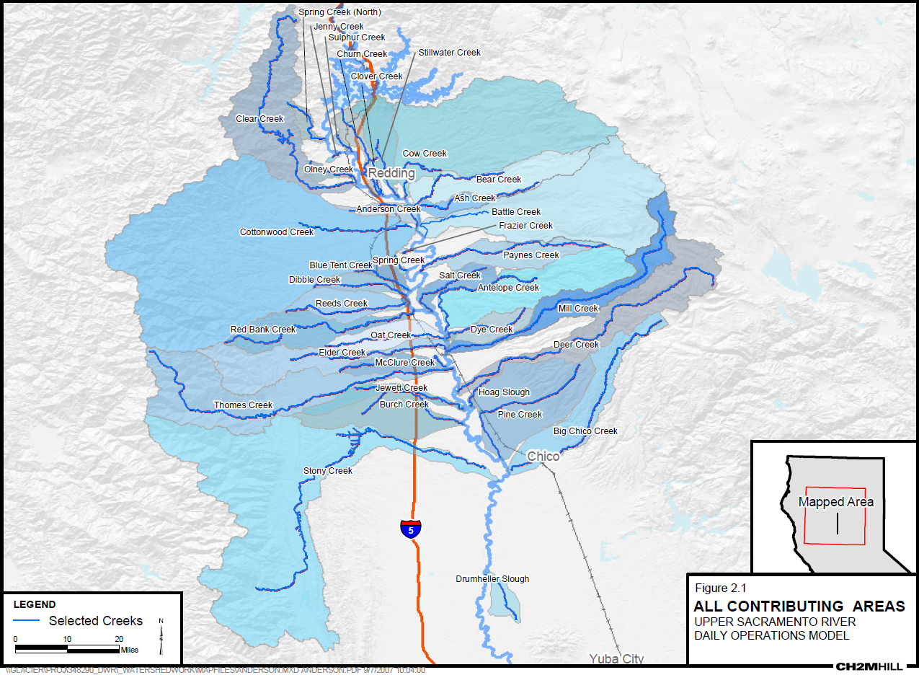
Daily Operations Model Watershed

Slide 15
Combined Storage During Extremely Dry Conditions
(Shasta, Oroville, Folsom)
15
Level at which DWR and Reclamation submitted a Temporary Urgency Change Petition on January 29, 2014
Notes:
Click for red line. Then, click for Sites (green bars)
Fritz:
▪ Blue incorporates today’s environmental compliance obligations and level of water demand onto the historic hydrology associated with past droughts to estimate the end-of year storage in Shasta, Oroville, & Folsom
▪ Red line shows when the Projects pursued the TUCP process
▪ The green is how much water Sites could have diverted under current environmental compliance obligations and ensuring that senior water right holders demands were met first.
When the next drought comes, Sites will “move the needle” to ensure there is additional water for both the environment and for people

Slide 16
Combined Storage During Extremely Dry Conditions
(Shasta, Oroville, Folsom, & Sites)
16
Level at which DWR and Reclamation submitted a Temporary Urgency Change Petition on January 29, 2014
Notes:
Benefits of Sites
Not able to address all years, but definitely can move the needle

Slide 17
SALMOD Results
(Longterm)
 | 2030 |  |  | 2070
Sacramento River Chinook Runs | Without Sites | Sites Increment | % Change | Without Sites | Sites Increment | % Change
Winter | 1,996,967 | 68,269 | 3.4 % | 1,818,783 | 109,752 | 6.0%
Spring | 437,648 | 4,147 | 0.9% | 357,458 | 17,520 | 4.9%
Fall | 17,896,789 | 226,190 | 1.3% | 15,507,733 | 623,264 | 4.0%
Late-Fall | 2,892,264 | 20,442 | 0.7% | 2,744,016 | 95,108 | 3.5%
All Runs | 23,223,668 | 319,047 | 1.4% | 20,427,989 | 845,644 | 4.1%
17

Slide 18
SALMOD Results
(Incremental Change - Dry Years)
 | Dry Years |  |  | Critical Years
Sacramento River Chinook Runs | Current | 2030 | 2070 | Current | 2030 | 2070
Winter | 2.3% | 2.6% | 6.1 % | 2.3% | 14.8% | 66.7%
Spring | 1.3% | 0.3% | 6.3% | 20.2% | 6.0% | 64.8%
Fall | 1.6% | 0.6% | 7.0% | 3.9% | 3.1% | 11.3%
Late-Fall | 2.3% | 1.2% | 1.6% | 4.4% | 1.6% | 21.2%
18

Slide 19
Flow Stability Results
Flow Stabilization (Percent change in Average December-February flow increases from Keswick Dam)
Hydrologic Condition | 2030 | 2070
Long-term | 2.5% | 1.7%
Below Normal | 3.8% | 3.9%
Dry | 11.9% | 6.1%
Critical | 4.2% | 7.9%
19

Slide 20
OBAN Results
Long-term Average Escapement for Winter-Run Chinook Salmon (1971-2002)
 | Current | 2030 | 2070
Without Sites | 3997 | 2813 | 2258
Increment with Sites | 283 (7.1%) | 70 (2.5%) | 240 (10%.6)
Sites Increment with Flow-Mortality Correction | 264 (6.6% | 58 (2.1%) | 228 (10.1%)
20

Slide 21
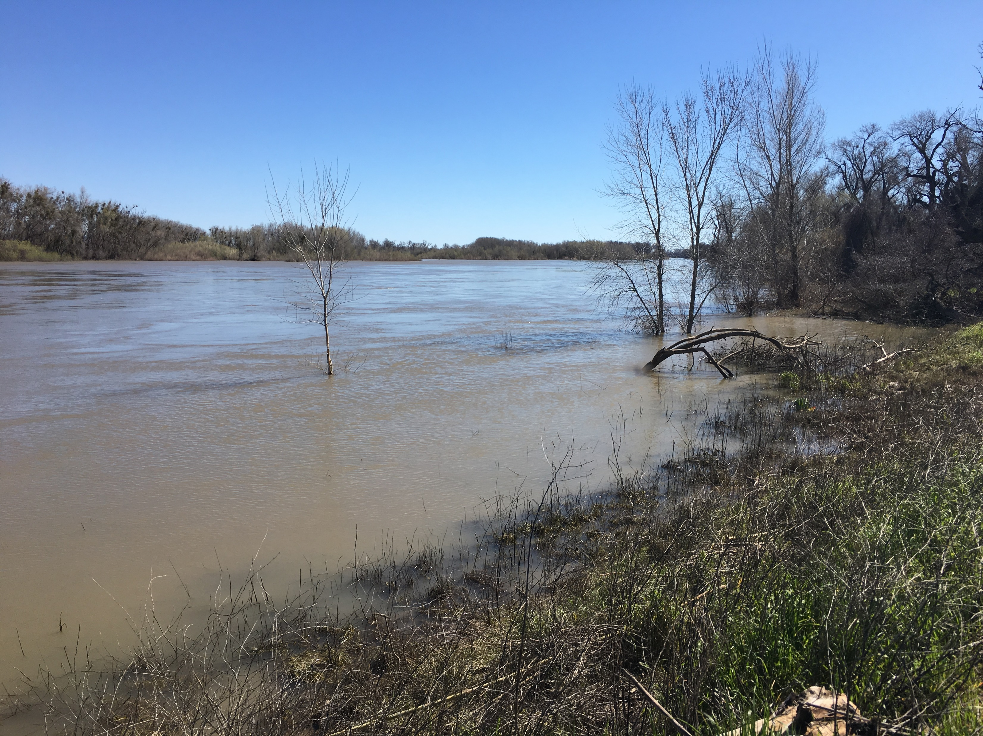
Next Steps?
Topics, Date

